Slide 1
Citizens Declare
State of Emergency with Georgia Election System
Voter Roll Manipulation
Failure to audit machines and follow State Law by SOS
Rossi/Moncla SEB2023-025
CISA, DHS, Halderman, 29 cybersecurity experts warn
Must go to Paper Poll Books and Emergency Paper Ballots with a Full Hand Count before Certification
On X @theGANerds
On Rumble.com
GeorgiansForTruth.org

Slide 2
Citizens Declare
State of Emergency with Georgia Election System
Rossi/Moncla SEB2023-025 Case
Over 140 violations of election law in Fulton
41,000+ ballots w/o image, tabulator tape or double counted
SOS investigator recommended referral to AG
GeorgiansForTruth.org

Slide 3
Citizens Declare
State of Emergency with Georgia Election System
Voter Roll Manipulation
2020, 2022, & 2024
Synthetic Identity Theft
Double Votes, Inserted Votes & Swapped Votes
Bartow
Brooks
Bulloch
Calhoun
Chatham
Chattooga
Clarke
Clay
Clayton
Cobb
Coweta
Dougherty
Elbert
Fannin
Floyd
Forsyth
Fulton
Green
Gwinnett
Hall
Hancock
Henry
Irwin
Jefferson
Lumpkin
Miller
Mitchell
Oconee
Peach
Pierce
Polk
Pulaski
Richmond
Spalding
Stephens
Whitfield
Wilkes
Wilkinson
On X @theGANerds
On Rumble.com
GeorgiansForTruth.org

Slide 4
Citizens Declare
State of Emergency with Georgia Election System
Failure to audit machines and follow State Law by SOS
SOS & Sterling perjured to Congress violates OCGA 16-10-1
DA / IG exposed to evidence appointed to judgeships
18 US Code § 2382 – Misprision of treason
WriteTheVote.net
GeorgiansForTruth.org

Slide 5
Citizens Declare
State of Emergency with Georgia Election System
CISA, DHS, Halderman, 29 cybersecurity experts warn
No change in Electronic Voting System since 2020
QR Code illegal
Williamson TN Error
BMD removes intent/ RLA fallacy (no intent)
GeorgiansForTruth.org

Slide 6
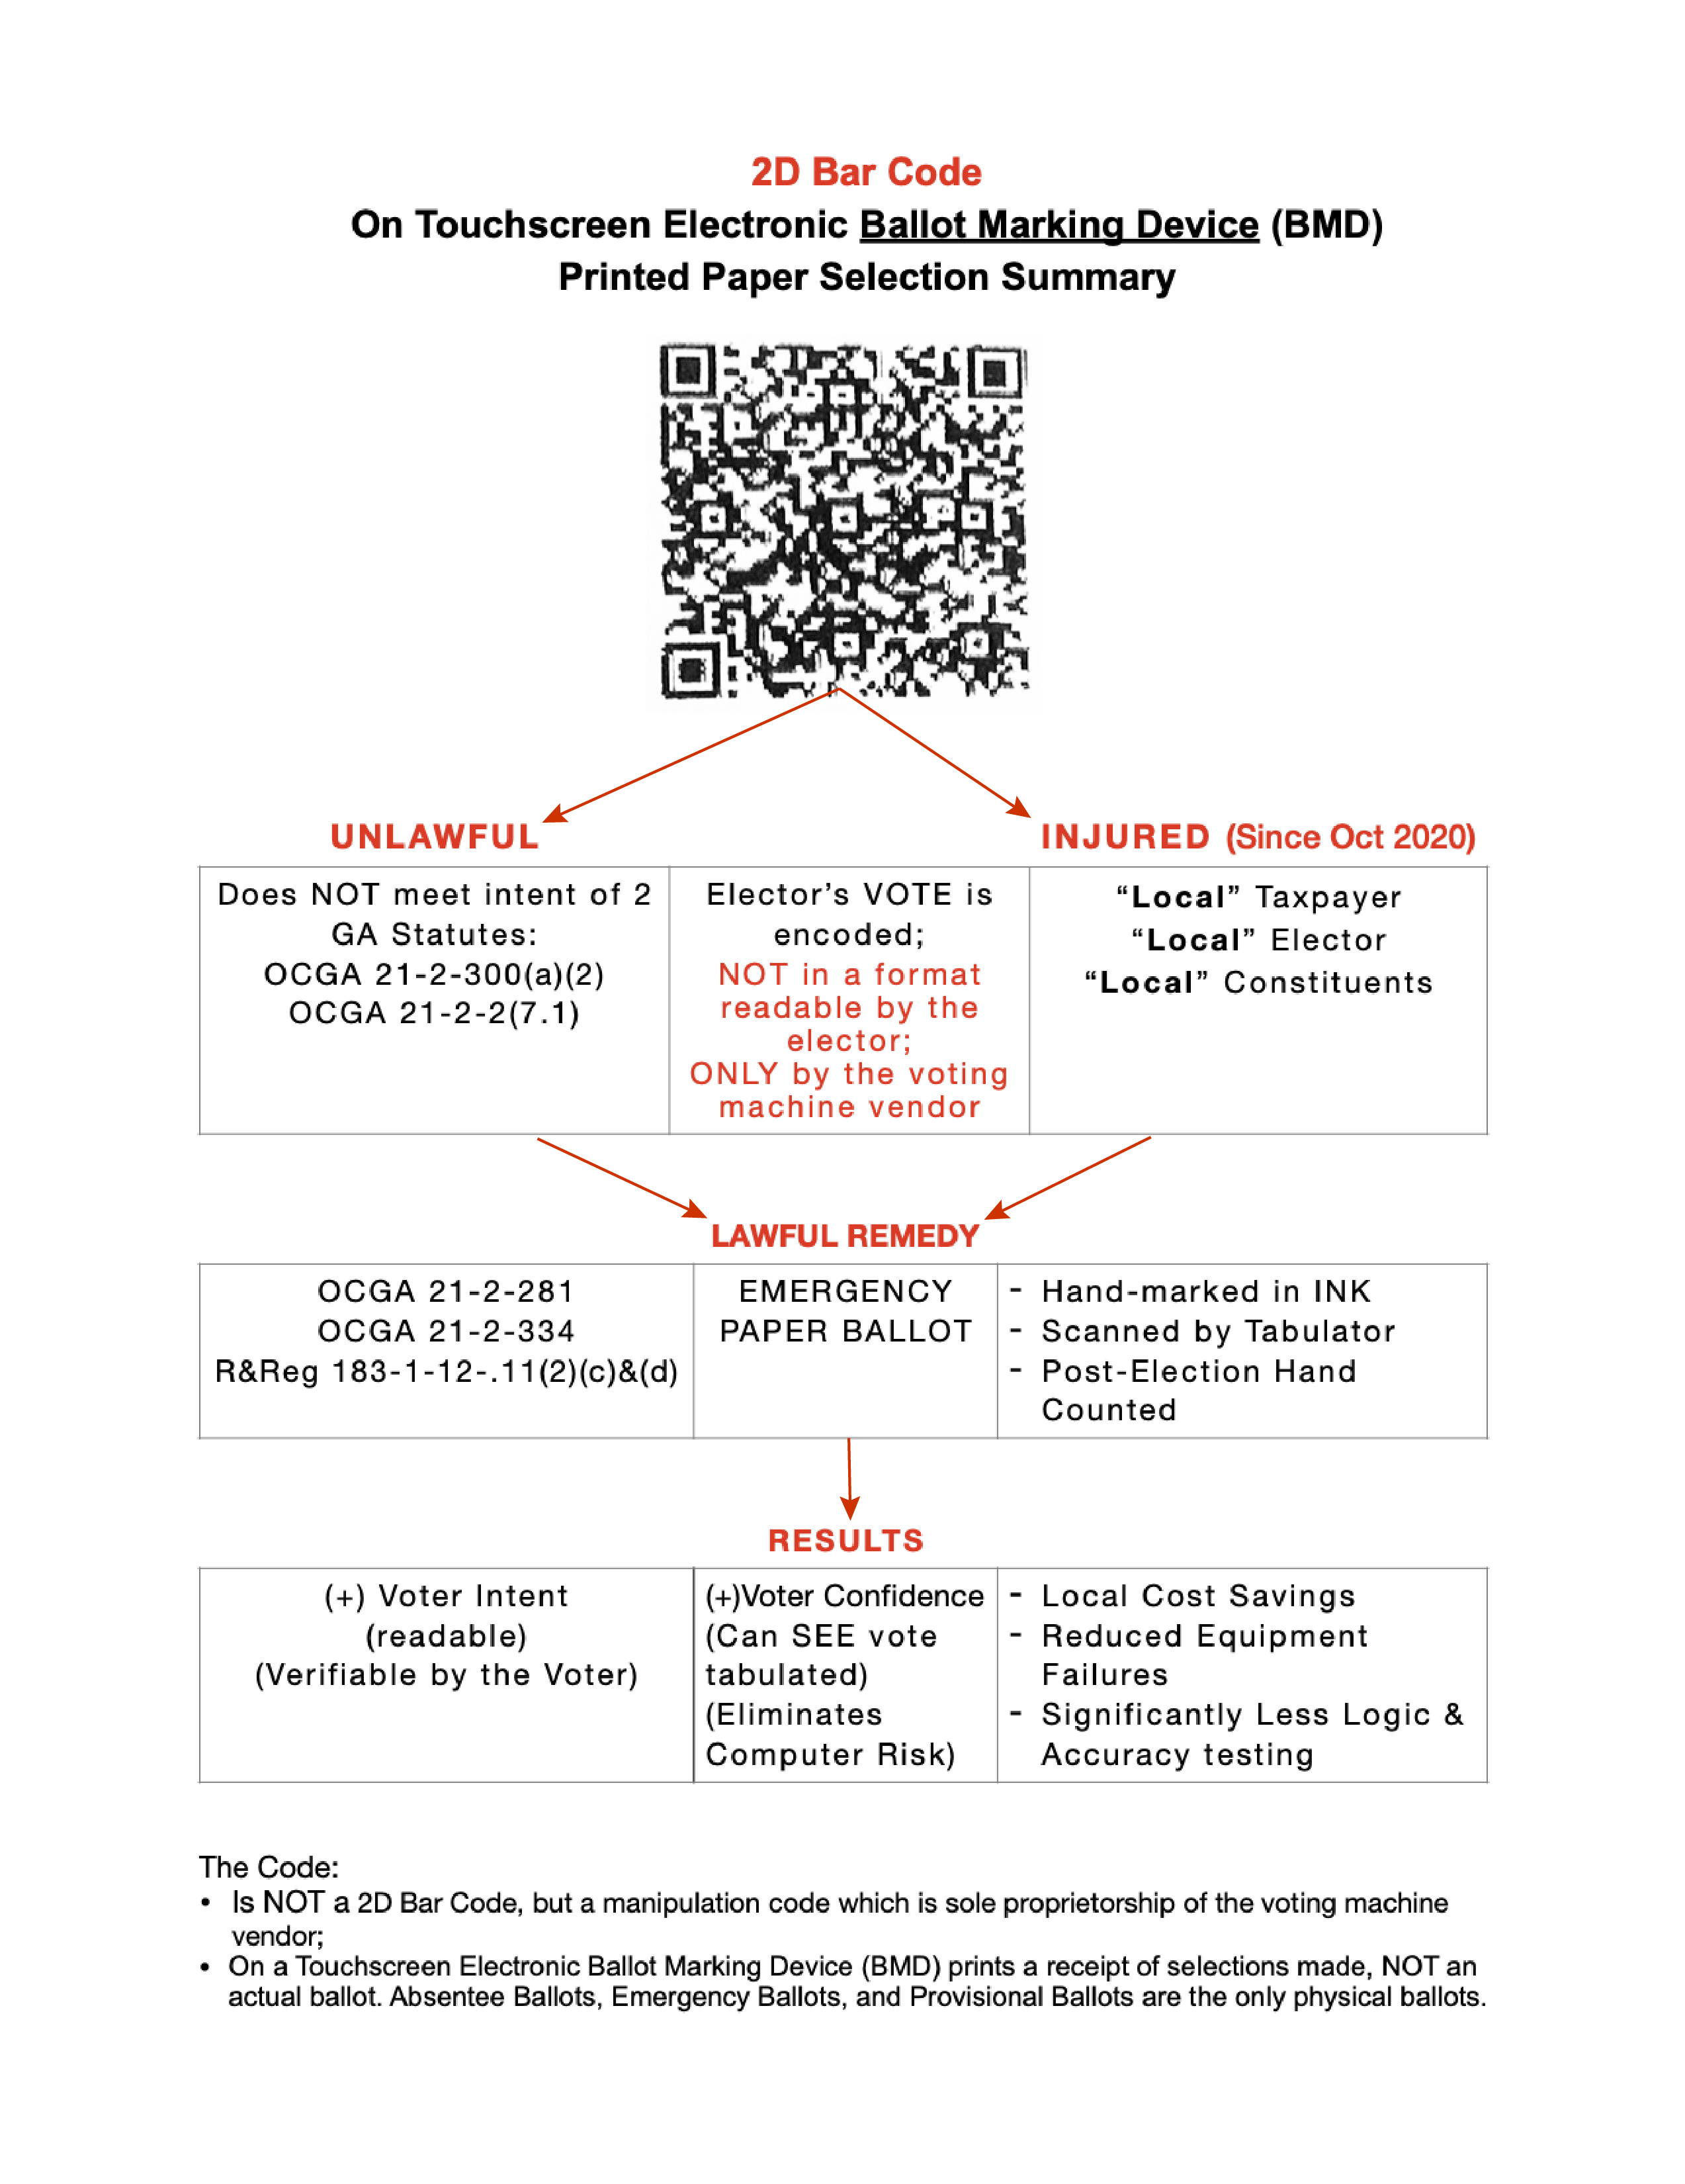
Citizens Declare
State of Emergency with Georgia Election System
Use Emergency Paper Poll Books
GA Rules & Regs 183-1-12-19
Use Emergency Paper Ballots
OCGA 21-2-281, 21-2-290, 21-2-334
One BMD for each precinct for Accessibility, Tabulator Count day of election, PLUS
Must Have Full Hand Count
Before Certification
OCGA 21-2-334, 21-2-437,
21-2-493
Duty to certify:
    Prevent fraud, deceit &
    abuse
    Make “True & Perfect”
    return
    OCGA 21-2-70-15
GeorgiansForTruth.org

